Slide 1
Discussion 10
Christine Zhou

Slide 2
Agenda
Announcements
Review/Worksheet Problems

Slide 3
Announcements
Happy Spring!
Mid-Semester Survey on Piazza
Turn in for some nice EC!
Any feedback would be greatly appreciated. Thanks so much!
HW3 due Thursday (3/23)
No grace period :(
Attendance: shoutkey.com/away

Slide 4
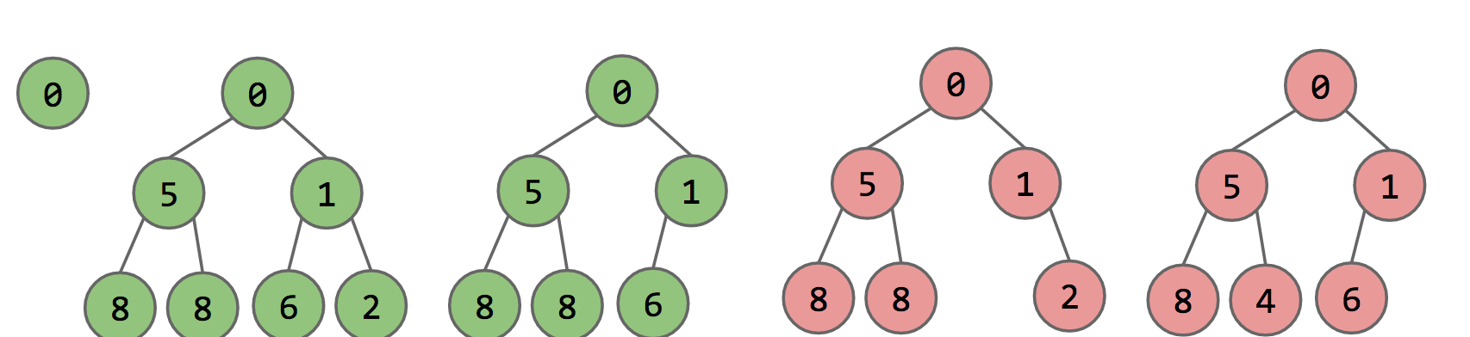
Heaps
Sometimes we want to always have access to the smallest item
Use a heap:
Complete: missing items only at the bottom level and pushed as far left on the bottom level as possible
Min-heap property: every node is less than or equal to its children’s value
Common methods:
insert, getMin, removeMin

Slide 5
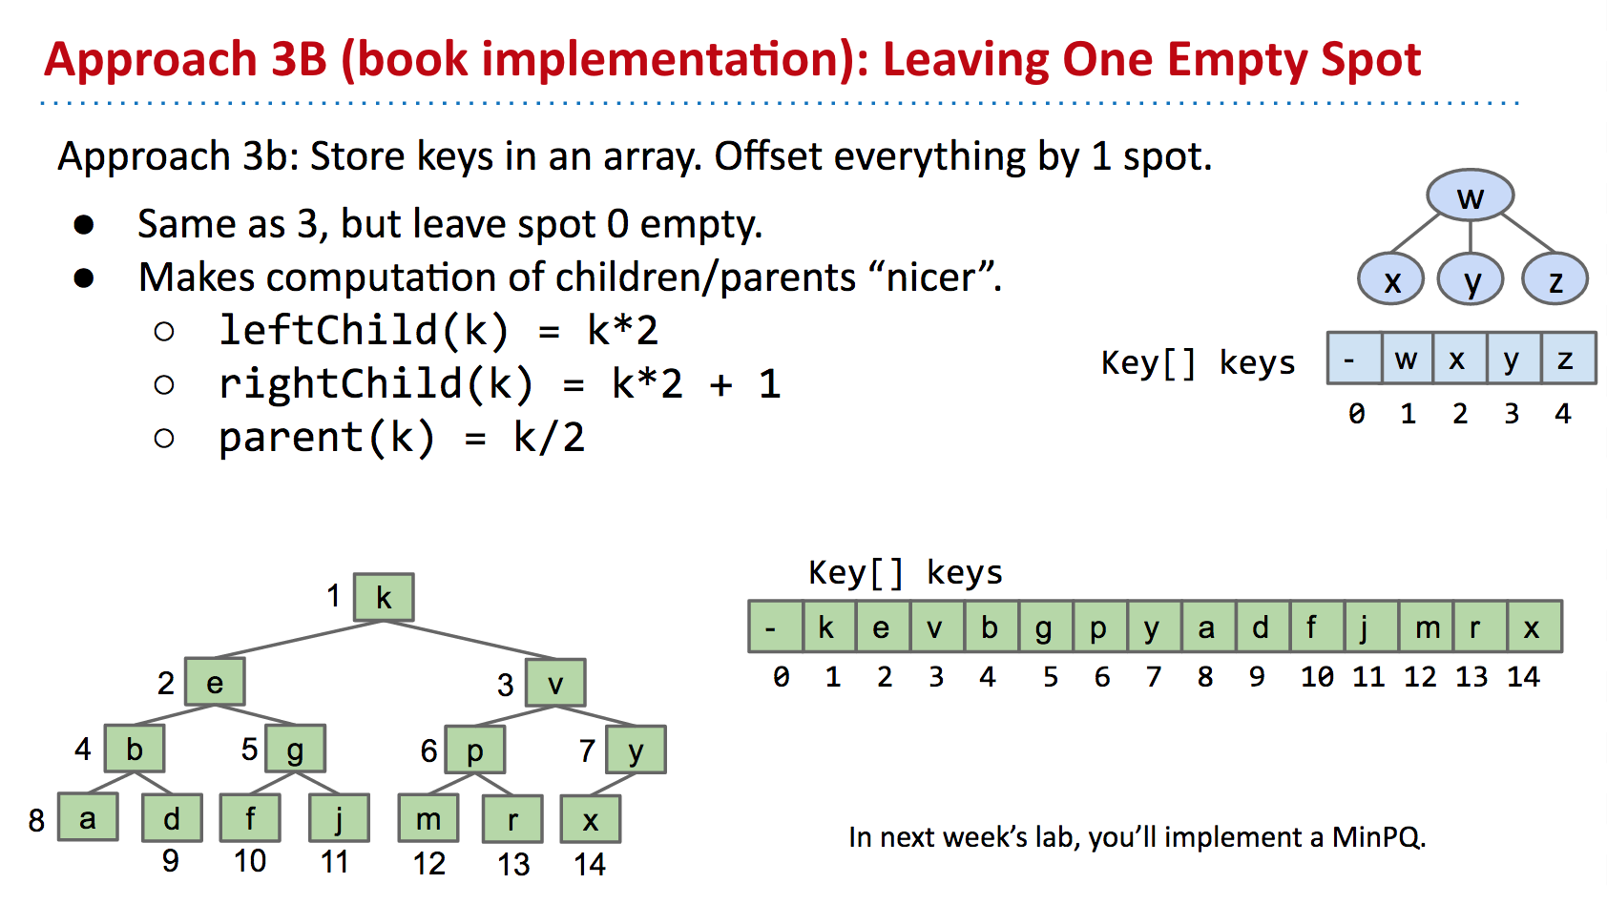
How do we represent heaps?

Slide 6
Graphs
Can represent relationships!
Family trees, cities and roads, etc.
Lots of terminology:
Vertices/nodes: graphs are made up of a set of these
Edges: connect two vertices together (can be (un)directed)
Adjacent: vertices with an edge between them
Labels/Weights: the value of a vertex or edge
Path: vertices connected by edges
Cycle: path whose first and last vertices are the same
Connectivity: vertices are connected if there is a path in between them; graphs are connected if all vertices are connected

Slide 7
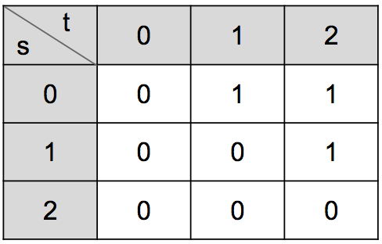
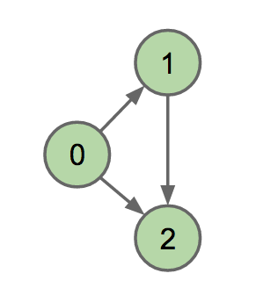

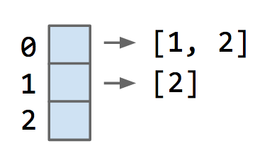
How do we represent a graph?
Adjacency matrix
Edge set
Adjacency list

Slide 8
Depth First Search (DFS)
Search down entire subgraph of a child before moving onto the next child
Keep searching the first child until no more children left to explore, then move onto the second child
If there are multiple children that you could explore, break ties alphabetically
Preorder: note the vertex when you first visit it
Postorder: note the vertex when you return from it (when all its children have been visited)
Runtime: O(V + E)
https://docs.google.com/presentation/d/1lTo8LZUGi3XQ1VlOmBUF9KkJTW_JWsw_DOPq8VBiI3A/edit#slide=id.g76e0dad85_2_380

Slide 9
Breadth First Search (BFS)
Search graph equidistantly from the source
Start at the root, search all the children, then do the same with all the other children
Runtime: O(V + E)

